Slide 1
Trumpland
How President-Elect Trump Can Affect Your Business and Your Future

Slide 2
The incoming Administration
Will be sworn in as the 45th President of the United States on January 20, 2017
The governing Republican Party will have majorities in the House of Representatives and the Senate for the next 2 years
The opposition Democratic Party may, in some circumstances, block legislation in the upper house, the Senate
Republicans also hold 33 governor’s offices and 32 state legislatures nationwide (including full control of 24 States)

Slide 3
The President-Elect’s Promises Prior to the Election
Repeal the Patient Protection and Affordable Care Act (i.e. “Obamacare”)
Build “The Wall” between Mexico and the United States
Total ban Muslims from seeking asylum or “extreme vetting”
Deport illegal immigrants residing in the United States
Withdraw from the Paris Agreement on climate change
Reintroduce waterboarding and other methods of torture
Appoint conservative judges to the Supreme Court to overturn gay marriage and abortion decisions to return these matters to the individual States
Reject Trans Pacific Partnership (TPP) and Transatlantic Trade and Investment Partnership (TTIP)
Withdraw from the North American Free Trade Agreement (NAFTA)
Make the mutual defense requirement of Article 5 of the North Atlantic Treaty (NATO) conditional upon increased financial contributions by European countries
Repeal the Dodd-Frank Act, which governs Wall Street
Prosecute Hillary Clinton

Slide 4
Political Effect of the U.S. Election IN EUROPE
After back-to-back wins in the United Kingdom Brexit vote and the American presidential election, nationalists and far right parties in Europe are emboldened
Marine Le Pen of the National Front will almost certainly make it into the second round of the French presidential election in May 2017 and she is pledged to call a “Frexit” vote if she wins the Elysee Palace
Geert Wilders of the Dutch Freedom Party is seeking a “Nexit” vote for the Netherlands
On December 4, Norbert Hofer of the far-right Freedom Party is likely to be elected President of Austria and has stated he will not swear in any minister who wears a veil and will dismiss any chancellor who fails to control immigration
Also on December 4, Italian Premier Matteo Renzi is expected to lose a referendum on constitutional revision, which has become a vote of confidence in his leadership, and promptly resign
In light of the American election result and the far-right Alternative for Germany party entering 10 state parliaments, German Chancellor Angela Merkel has decided to run for a fourth term in next year’s federal elections -- the New York Times has gone so far as to declare her the liberal West’s last great defender

Slide 5
Devalued Euro and POUND Sterling
As the Euro (EUR) and the Pound Sterling (GBP) drop in value in relation to the US Dollar (USD), capital will leave European countries because investors will prefer safer USD-denominated assets, including U.S. securities
June 23, 2016:
UK referendum on
EU membership
November 9, 2016:
Day after U.S.
general election

Slide 6
Devalued Euro and POUND Sterling
June 23, 2016:
UK referendum on
EU membership

Slide 7
The demise of Trade Agreements
With the election of Donald Trump, both TPP (US & Asia-Pacific) and TTIP (US & Europe) are dead
As a result, more than 18,000 tariffs that would have been phased out under the TPP alone will remain
While less than half of US-EU trade is subject to customs duties, the US levies duties ranging from 1-3% for basic goods, 30% for clothes and shoes, and, sometimes, more than 100% (130% for peanuts and 350% for raw tobacco), which would have been eliminated under TTIP

Slide 8
The demise of Trade Agreements
The US and individual European countries will have to negotiate bilateral trade deals
While larger economic powerhouses like Germany, France, and the United Kingdom are likely to win more favorable terms, the same cannot be said for their smaller European counterparts
Rather than Europeans speaking with one voice when negotiating with the US, European countries will have to compete with each other to get the lowest tariffs for their goods (e.g. French champagne vs. Italian prosecco)

Slide 9
The demise of Trade Agreements
The US and individual European countries will have to negotiate bilateral trade deals
While larger economic powerhouses like Germany, France, and the United Kingdom are likely to win more favorable terms, the same cannot be said for their smaller European counterparts
Rather than Europeans speaking with one voice when negotiating with the US, European countries will have to compete with each other to get the lowest tariffs for their goods (e.g. French champagne vs. Italian prosecco)
These trade deals will still need to be ratified by the normal constitutional procedure and, in the case of EU countries, comply with EU law

Slide 10
The demise of Trade Agreements
Increased US tariffs
Reduced overseas imports because of uncompetitive prices
Rise in value of US dollar
Reduced US exports because of increased prices
Inflationary pressure exerted on foreign central banks
Foreign central banks raise interest rates to prevent further devaluation of their currencies
Foreign currencies stabilize in relation to the dollar
American exports and foreign imports increase as dollar loses value relative to other currencies

Slide 11
Fiscal stimulus
President-elect Trump has promised to increase government spending by 2-3% (primarily on America’s crumbling infrastructure) but fiscal conservatives in Congress may block his plans
If the infrastructure spending plans are adopted, this may result in greater overseas imports
The incoming administration also plans to cut the corporate tax rate from 35% to 15%, which would transform the US into one of the most tax competitive nations in the world at the expense of Ireland and other European countries with low corporate tax rates

Slide 12
NATO
The President-elect has signaled that NATO members must shoulder a larger share of the financial burden within the Alliance if they expect the US to continue to provide military protection
With many NATO members watching Russia’s increased assertiveness with concern, especially the Baltic states, these countries may have to cut other spending, raise taxes, or run budget deficits to dedicate increased funds to the Alliance

Slide 13
Nato
However, NATO members who are also EU members, must keep budget deficits within 3% of GDP to avoid running afoul of the European Commission

Slide 14
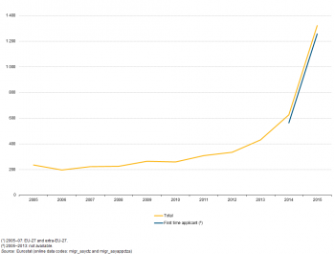
Refugee/Migrant Crisis
Sharp increase in persons seeking asylum in the European Union starting in 2014

Slide 15
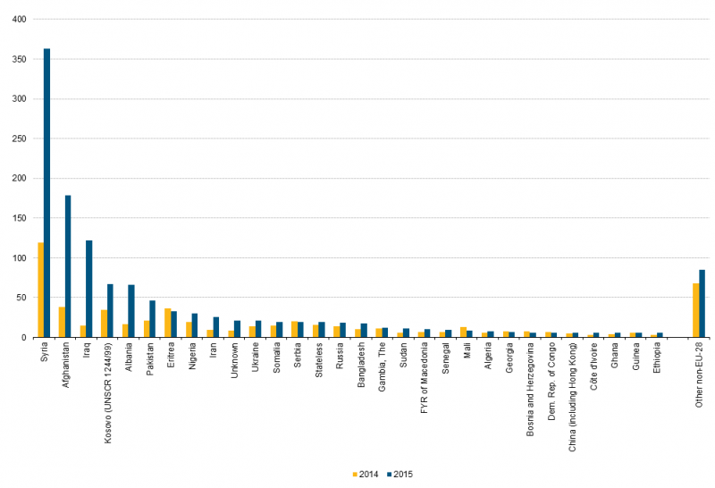
Refugee/Migrant Crisis
Massive increase in number of asylum applications from Syrian, Afghans, and Iraqis

Slide 16
Refugee/Migrant Crisis
Although Germany only represents 16% of the EU’s population, it has received 35% of all asylum applications.
The differences are even more stark in Hungary and Sweden, which together consist of less than 6% of the EU’s population but have received 33% of all asylum applications.
On the other hand, the UK, Spain, and France have received comparatively few asylum applications on a population basis

Slide 17
Refugee/Migrant Crisis
Has led to temporary introduction of border controls in several Schengen Area countries, including Sweden, Denmark, Germany, Austria, France, Poland, and Norway
An estimated 1.7 million Europeans cross national borders daily for work

Slide 18
Refugee/Migrant Crisis
Germany case study
In mid-2016, the 16 German states demanded an additional 8 billion euros from the federal government to alleviate the cost burden for refugee integration
The federal government expects to spend 20 billion euros a year to support refugees between 2016 and 2020
An additional 325,000 children have been enrolled in the public school system, which will require hiring 25,000 new teachers and support staff
20% of refugee children suffer from post-traumatic stress disorder (PTSD) and 50% have experienced trauma
The labor participation rate for refugees is low but increasing as they learn German and receive further education or vocational training
In short, the influx of asylum seekers has placed a tremendous strain on Germany’s finances, education system, and labor market.

Slide 19
2017 Forecasts
According to Focus Economics, the Eurozone economy is expected to grow 1.4% in 2017, down from 1.6% in 2016, as a result of “a reduction in tailwinds to domestic demand as inflation rises . . . combined with the political[ly] uncertain atmosphere.”
Country-specific forecasts:
Germany: 1.4%
France: 1.2%
Italy: 0.8%
Spain: 2.2%
Inflation is projected to rise from 0.2% in 2016 to 1.3% in 2017, which is closer to the European Central Bank’s goal of 2.0%

Slide 20
2017 Forecasts
According to the Organisation for Economic Co-operation and Development (OECD), President-elect Trump’s lower tax and higher spending policies will raise US economic growth by an additional 0.4% and push global GDP growth closer to 4% in 2017

